Slide 1
📊
Google Sheets
Text Functions
Before & After Practice

Slide 2
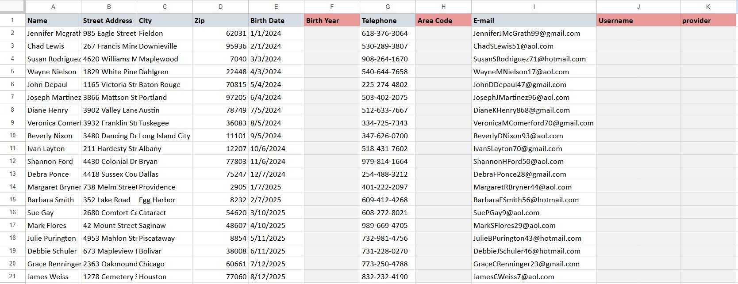
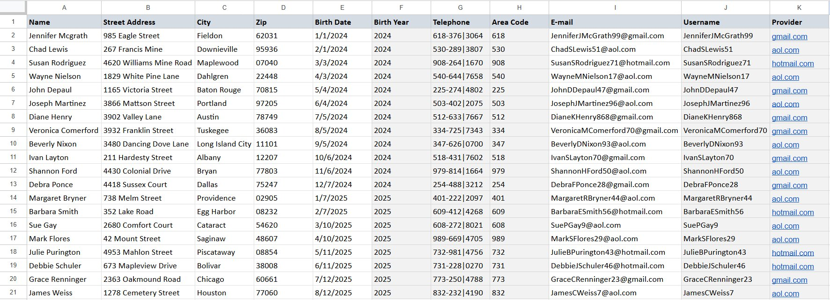
1
Data Extraction & Cleanup
Splitting email addresses, extracting phone components, filling missing columns
BEFORE
AFTER
→
Extracted Birth Year
Formatted Phone with |
Extracted Area Code
Find Username & Provider

Slide 3
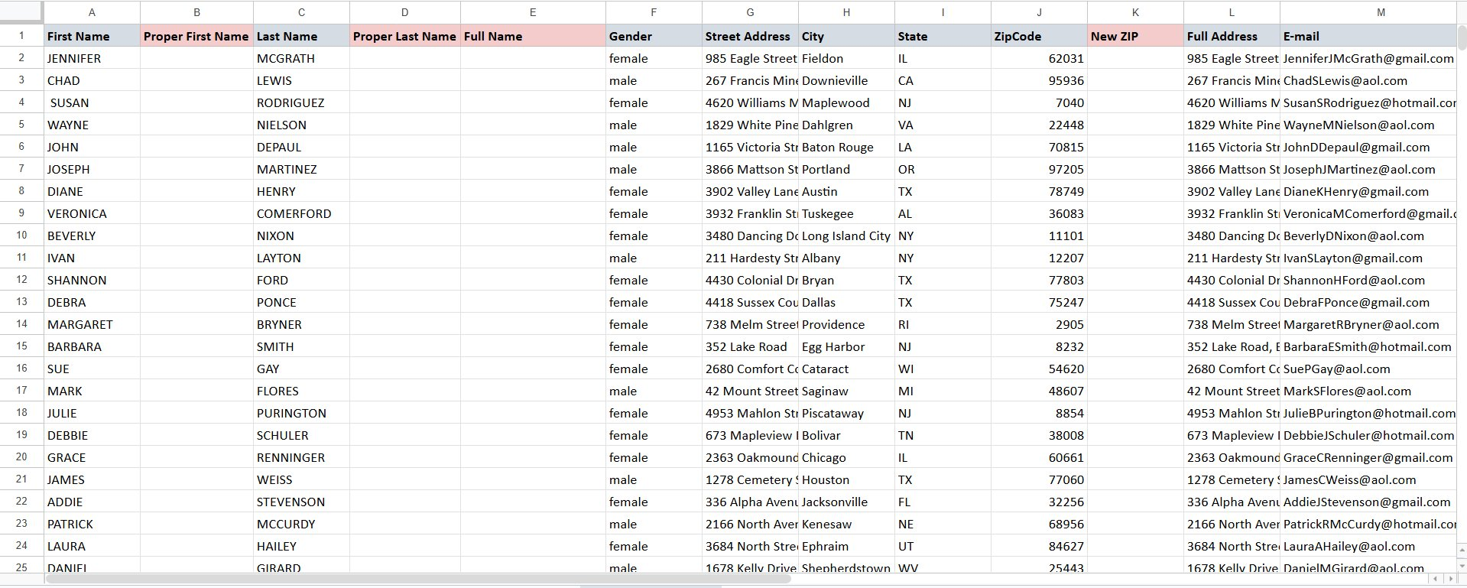
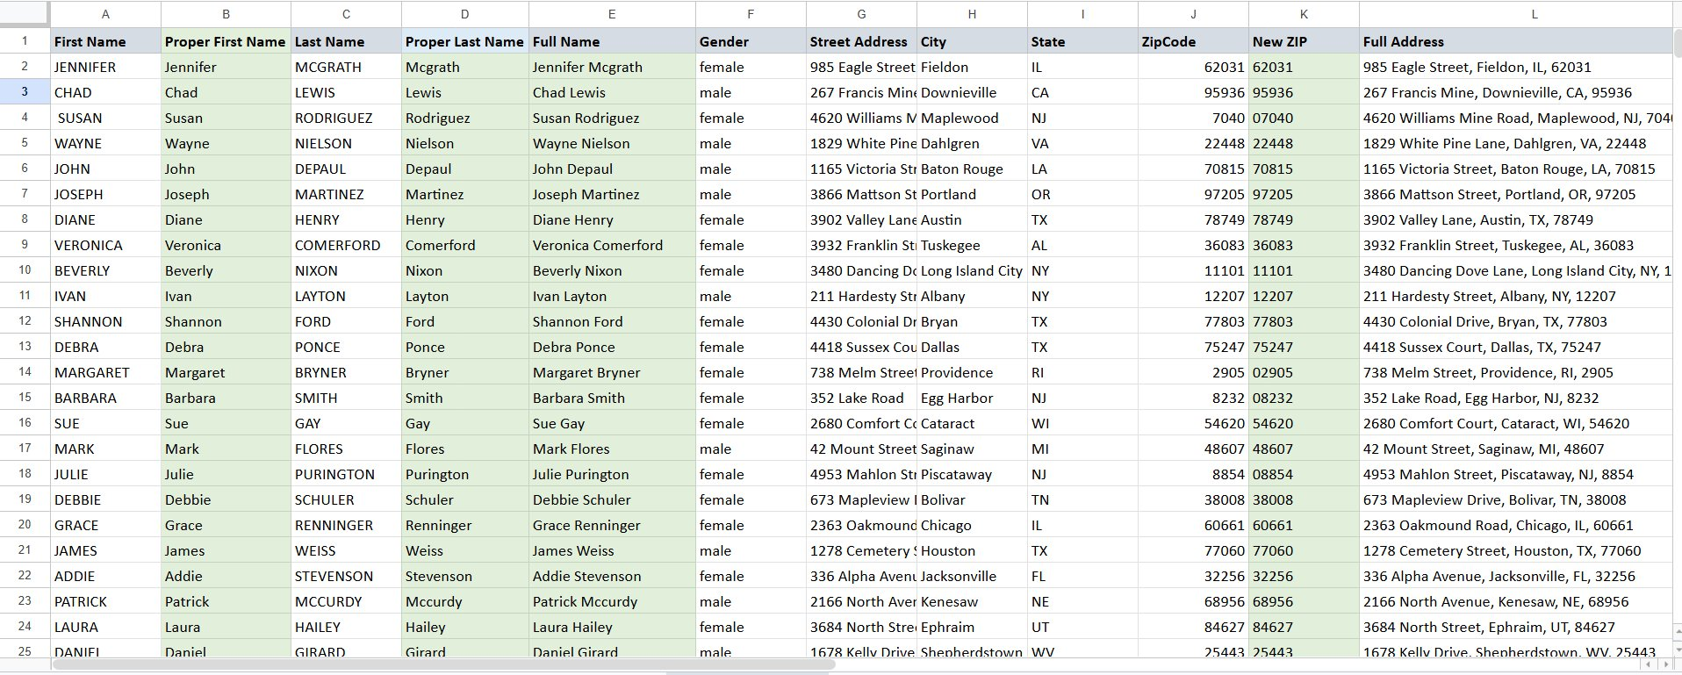
2
PROPER & Text Combining
Converting ALL CAPS names to Proper Case, building Full Name & Full Address columns
BEFORE
AFTER
→
PROPER() on First Name
PROPER() on Last Name
Combined Full Name
Fixed ZIP with leading zero

Slide 4
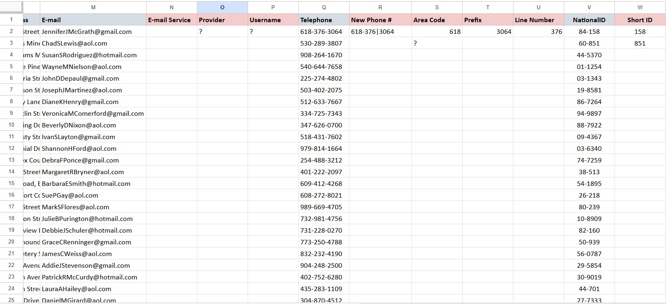
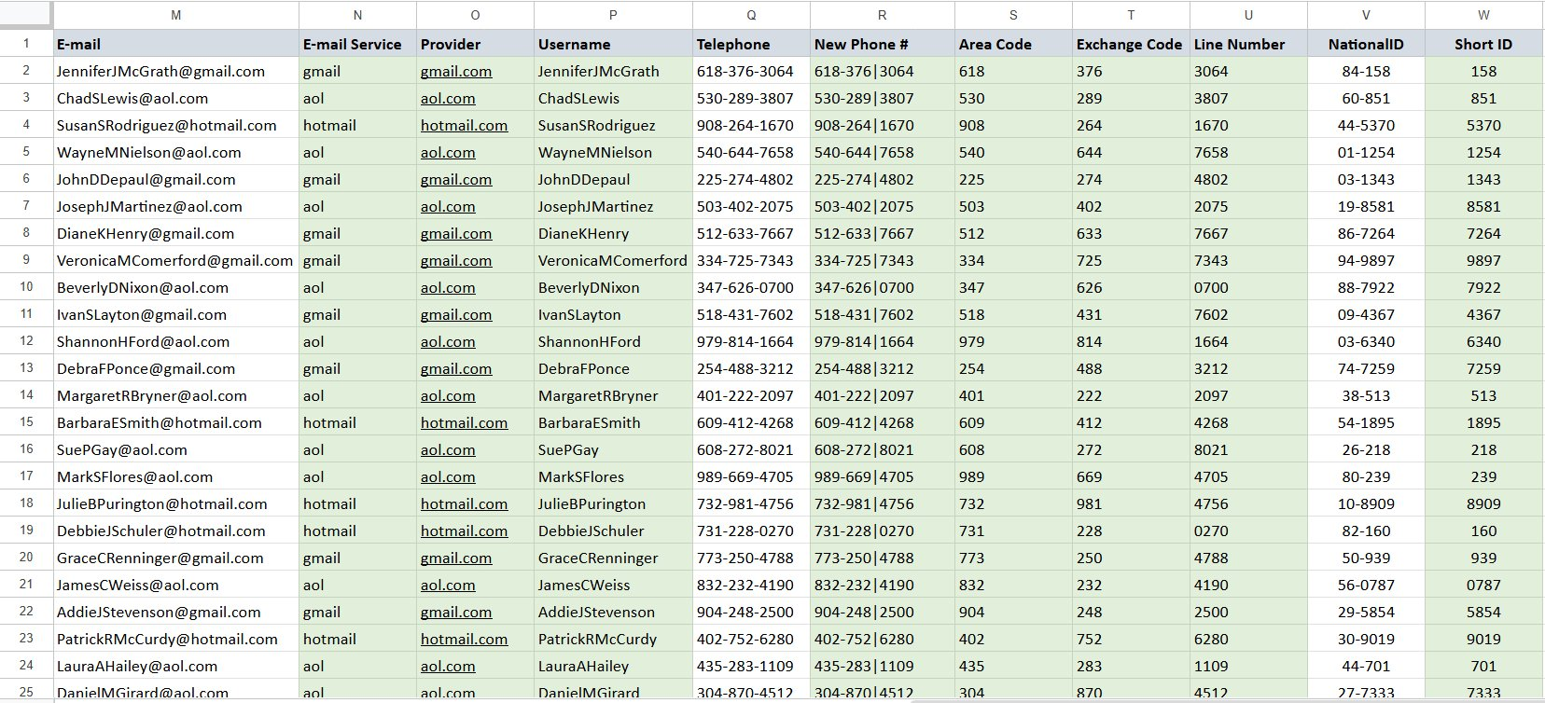
3
Email & Phone Parsing
Extracting email service, provider, username and splitting phone into components
BEFORE
AFTER
→
Extracted Email Service
Extracted Provider domain
Pulled Username
Area Code / Exchange / Line split
Fixed Short ID

Slide 5
🎯
Functions Practiced
A summary of all Google Sheets text functions used across the exercises
PROPER()
YEAR()
LEFT() / RIGHT()
Converts text to Title Case
Extracts year from a date
Extracts characters from text
MID()
FIND()
TEXT()
Extracts text from the middle
Finds position of a character
Formats numbers as text
TEXTJOIN
LEN()
SUBSTITUTE()
Joins multiple text strings
Returns length of a string
Replaces text within a string

